Slide 1
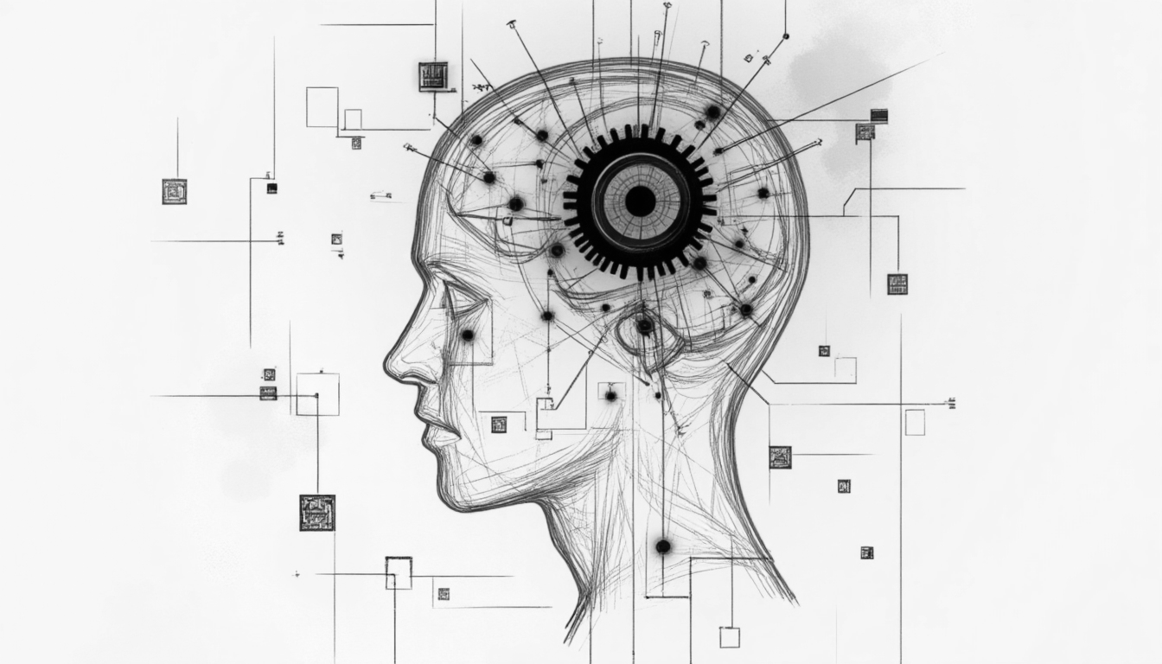

Lecture 1: Machine Learning Overview
CSE445 Machine Learning
Dr. Jilan Samiuddin (JSA)
Assistant Professor
North South University

Slide 2
Class Information
Course Name: Machine Learning
Course Code: CSE 445
Credit Hours: 3
Pre-requisites: CSE 348 or Consent from Instructor

Slide 3
Instructor Information
Instructor Name: Dr. Jilan Samiuddin (JSA)
Position: Assistant Professor, ECE
Email: jilan.samiuddin@northsouth.edu
Office: SAC 911
Office hours: Posted in Canvas (Announcements)

Slide 4
Tentative Marks Distribution
Attendance: 5%
Project: 20%
Quiz/Class Test: 20% (the worst quiz grade will be discarded)
Midterm: 25%
Final Exam: 30%

Slide 5
Class Rules
General Conduct
Punctuality: Arrive on time and stay for the entire class session.
Respect: Treat instructors & classmates with respect and courtesy.
Participation: Engage actively in discussions and group activities when required.
No Disruptions: Avoid talking out of turn or engaging in off-topic activities.
Phone Use: Keep mobiles in silent mode or turn off during class.
Recording: Do not record lectures without the instructor’s permission.
Academic Integrity
Any kind of cheating is strictly prohibited
Communication
Office Hours: Attend during posted times or schedule appointments in advance.
No makeup Quizzes
You are responsible for ensuring your attendance
If an attendance is not registered, it must be rectified within the same day in-person

Slide 6
Let’s discuss
How many of you want to study abroad for higher education (Masters or PhD)?

Slide 7
Let’s discuss
Take out a small piece of paper and write what you read:
CH₄
Esc
Becoming educated is more important than just being literate
Moreover, morally educated (সুশিক্ষিত) is way way way more important than just being educated. In fact, there is no alternative to being morally educated.
Morally Educated >>>>>> Educated >> Literate

Slide 8
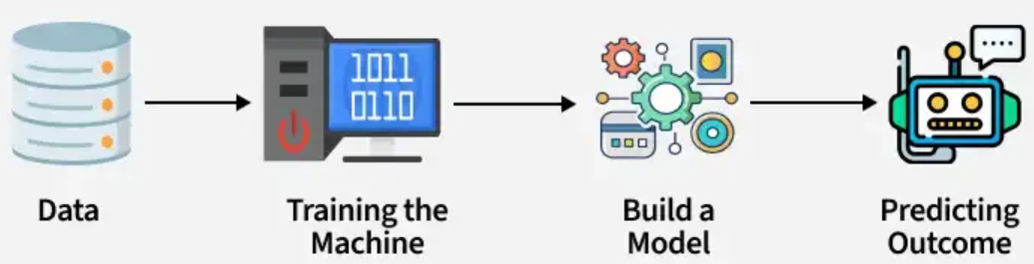

Introduction
Machine Learning (ML) is a subset of Artificial Intelligence (AI) focused on enabling computers to learn from data without explicit programming for each task
It mimics human-like learning by identifying patterns and making data-driven decisions
ML relies on statistical techniques to train algorithms and generate predictions
By leveraging historical data, these algorithms provide valuable insights that help businesses make informed, intelligent decisions.
I can learn from experience. Can you?
Yes, I can learn from past data with ML
Source: GeeksforGeeks

Slide 9
ML, AI and Deep Leaning (DL)
 | AI | ML | DL
Definition | Machines that mimic human intelligence (e.g., reasoning, learning, decision-making) | A subset of AI where machines learn from data without explicit programming | A subset of ML that uses neural networks with many layers ("deep" structures) to learn patterns
Definition in lay terms | The big picture | AI’s learning engine | ML’s supercharged brain for tough tasks
Example | Imagine building a self-driving car
 | The car’s ability to drive, obey traffic rules, and avoid collisions | The car learning to recognize stop signs by studying thousands of labeled images | The car figuring out on its own that a blurry red octagon is a stop sign, even if it is partially hidden

Slide 10
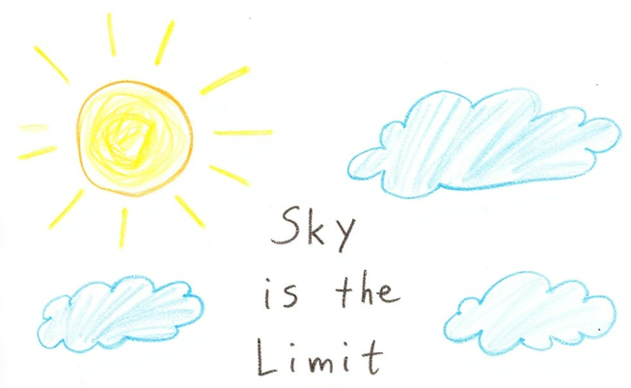
Why ML?
Solving Complex Business Problems → Excels in areas like image recognition, NLP, and diagnostics → Learns from data without predefined rules
Handling Large Volumes of Data → Processes massive data generated daily in the internet → Extracts insights and enables real-time decisions
Automating Repetitive Tasks → Performs routine tasks with precision → Reduces manual workload and errors
Personalized User Experience → Analyzes user behavior to deliver tailored content
Self-Improving Performance → Continuously adapts and refines based on new data

Slide 11
How ML learns?
Data Input
The system receives raw data (e.g., images, text, numbers) to analyze.
Algorithm Processing
Algorithms identify patterns and relationships within the data.
Model Training
The model adjusts its internal parameters using mathematical methods to learn from data.
Feedback Loop
Predictions are compared to actual outcomes, and errors are minimized using techniques like gradient descent.
Iteration and Learning
The model improves through repeated exposure to data, enhancing accuracy over time.
Evaluation and Generalization
Performance is tested on new, unseen data to ensure real-world reliability.

Slide 12
Types of ML
Supervised Learning | Unsupervised Learning | Semi-supervised Learning | Self-supervised Learning | Reinforcement Learning
Involves training a model on labeled data, where each input is associated with a known output. The model learns by comparing its predictions to the correct answers and adjusting accordingly. | Models work with input data that lacks labels. The goal is to uncover hidden patterns or groupings in the data without predefined categories. | Combines a small amount of labeled data with a large volume of unlabeled data. This approach helps build models that generalize well, bridging the gap between supervised and unsupervised learning. | Uses un-labelled data to generate its own labels through pretext tasks. These automatically generated labels serve as supervision for training, enabling the model to learn useful representations without manual labeling. | Trains an agent to make decisions by interacting with an environment. Through trial and error, the agent learns to maximize cumulative rewards without explicit instructions.

Slide 13
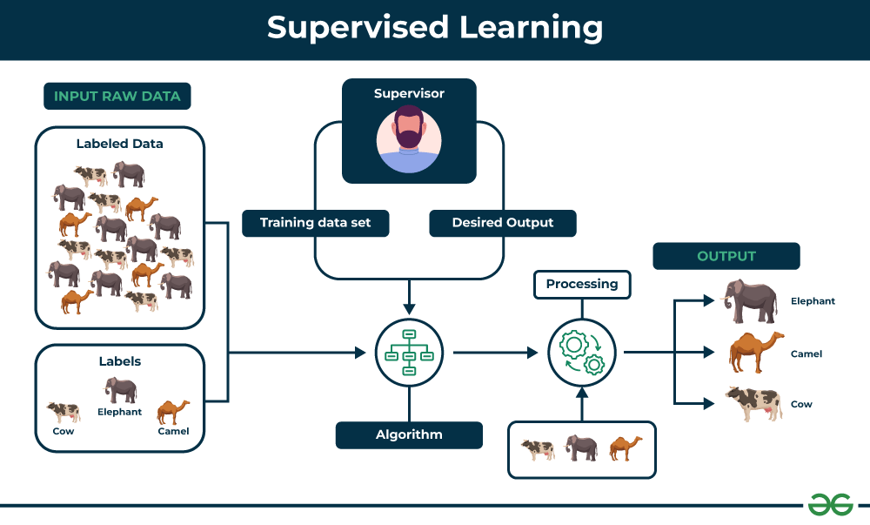
Supervised Learning
Source: GeeksforGeeks

Slide 14
Supervised Learning Categories
Classification task
The algorithm learns to assign input data to one of several predefined categories or labels. This is useful when the output variable is categorical, meaning it represents distinct classes.
Example: Classify emails as “spam” or “not spam”
Output type: Discrete categories or classes
Common Algorithms: Decision Trees, Support Vector Machines (SVM), Logistic Regression, k-Nearest Neighbors (KNN), Naive Bayes, Neural Networks (for classification)
Regression task
The goal is to predict a continuous numerical value based on input features. The algorithm tries to find the relationship between variables to make accurate numeric predictions.
Example: Predict future stock prices using historical data
Output Type: Continuous numerical values
Common Algorithms: Linear Regression, Ridge Regression, Random Forest Regression, Gradient Boosting Regressor, Neural Networks (for regression)

Slide 15
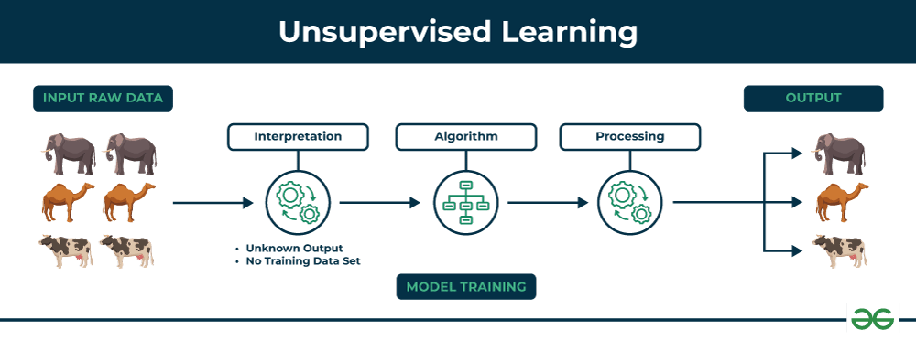
Unsupervised Learning
Source: GeeksforGeeks

Slide 16
Unsupervised Learning Categories
Clustering
Aims to group similar data points into clusters based on shared characteristics or distances in feature space. These clusters are formed in such a way that data points within the same group are more similar to each other than to those in other groups.
Example: Organizing articles into topics without prior labeling
Common Algorithms: k-Means, Hierarchical Clustering, Gaussian Mixture Models (GMM)
Dimensionality Reduction
Used to reduce the number of input features while preserving the most significant patterns in the data. This helps in visualization, noise reduction, and improving the performance of other machine learning algorithms.
Example: Feature compression before feeding data into a classifier
Common Algorithms: Principal Component Analysis (PCA), t-SNE, UMAP, Autoencoders
Association Rule Learning
Identifies interesting relationships, correlations, or co-occurrences among items in large datasets. These rules help in understanding how items or features are related.
Example: Discovering that customers who buy bread often buy butter
Common Algorithms: Apriori, Eclat, FP-Growth

Slide 17
Learners in ML
Lazy learners do not build a model during training – they simply store the training data and wait until prediction time to generalize
They are slower at predicting but adapt easily to new data since they don’t assume a fixed model
Examples: Classification: k-NN, Regression: k-NN Regressor, Clustering: Instance-based clustering (rare)
Eager Learners create a generalized model during training, which is then used to make fast predictions on new data.
They are faster at predictions but require retraining if new data is introduced.
Examples: Classification: SVM, Decision Trees, Regression: Linear Regression, Clustering: k-Means (model-based)

Slide 18
Lazy Learners vs Eager Learners
Aspect | Lazy Learners | Eager Learners
Learning Approach | Instance-based: No explicit model is built. | Model-based: Constructs a generalized model during training.
Training Phase | Minimal computation; simply stores training data. | Computationally intensive; builds a model from the data.
Generalization Timing | Generalizes at prediction time (on-the-fly). | Generalizes during training (before seeing test data).
Memory Usage | High (stores entire training dataset). | Low (discards training data after model creation).
Prediction Speed | Slower (processes data during each query). | Faster (uses pre-built model for predictions).
Handling Training Data | Retains all training data for future predictions. | Discards training data after model construction.
Adaptability | Easily adapts to new data (just add to stored dataset). | Requires retraining to incorporate new data.
Training Time | Short (only stores data). | Long (computes model parameters/structures).
Prediction Complexity | High inference cost (e.g., distance calculations). | Low inference cost (uses pre-computed model).
Examples | k-Nearest Neighbors (k-NN), Case-Based Reasoning. | Decision Trees, SVM, Neural Networks, Linear Regression.

Slide 19
Data Preprocessing
What: Preparing raw data for machine learning.
Why: Garbage in = garbage out! Clean data = better models.
Key Steps:
Handle missing data (e.g., remove rows or fill gaps).
Convert text/categories to numbers (e.g., "red" → 0, "blue" → 1).
Scale features (e.g., normalize values between 0 and 1).
Common techniques:
Missing Data: Use mean/median or drop rows.
Categorical Encoding: One-Hot Encoding (e.g., "cat" → [1,0], "dog" → [0,1]).
Feature Scaling: Standardization (mean=0, variance=1) vs. Min-Max Scaling.
Train-Test Split: Separate data into training (80%) and testing (20%).
Example: Preparing a dataset of house prices.

Slide 20
Model Evaluation
Goal: Ensure models work well on new, unseen data.
Overfitting: Model memorizes training data but fails on test data.
Key Terms:
Accuracy: % of correct predictions (good for balanced classes).
Precision: Trade-off for imbalanced data (e.g., fraud detection).
Metrics and validation:
Classification:
Confusion Matrix: TP, TN, FP, FN.
F1-Score: Balance precision and recall.
Regression:
MAE: Average error.
R²: How well the model explains data variance.

Slide 21
Ethics in ML
Bias: Models reflecting unfair stereotypes
Criminal Justice Algorithms: Used to predict the likelihood of reoffending.
Bias: Higher false positive rates for Black defendants
Privacy: Using personal data without consent
Transparency: "Black-box" models making unexplainable decisions
How to tackle:
Fairness: Audit models for biased outcomes.
Privacy Protections: Anonymize data; follow regulations
Transparency: Use interpretable models (e.g., Decision Trees) or explainability tools.

Slide 22
Challenges in ML
Data Bias and Fairness
Machine Learning models are only as reliable as the data they are trained on. If the data is biased, the outcomes can be unfair or discriminatory. Ensuring fair representation and regularly auditing models is essential.
Security and Privacy
Since ML systems depend on large volumes of data, they are vulnerable to data breaches and misuse. Handling sensitive or personal information requires robust security measures and strict adherence to privacy regulations.
Interpretability and Explainability
Many advanced ML models function as “black boxes,” making it difficult to understand how decisions are made. This lack of transparency can hinder trust, accountability, and regulatory compliance.
Job Displacement and Automation
The rise of automation powered by ML may replace certain types of jobs, especially in repetitive or routine tasks. Preparing the workforce through upskilling and reskilling is key to minimizing negative social impacts.

Slide 23
Current Trends
AutoML: Tools like Auto-Sklearn automate model selection.
Deep Learning: Revolutionizing image/text/speech tasks.
AI for Good: Climate modeling, healthcare diagnostics.
Ethical AI: Growing focus on fairness and regulations.
Generative AI

